Slide 1
ORL 5524-Session 1.0
Instrument Design and Validation
Madhabi Chatterji, Ph.D.
Professor of Measurement, Evaluation and Education
Director, Assessment and Evaluation Research Initiative (AERI)
Teachers College, Columbia University

Slide 2
What is ORL 5524 about?
1. Designing Assessment Instruments:
  Skills, basic measurement concepts/theory, vocabulary, hands-on experiences
  What you measure: Can vary (e.g., cognitive abilities, attitudes, social behaviors)
  How you measure: Can vary (e.g., tests, survey-based scales, performance assessments, etc. )
2. Validating instruments and measures as a part of the design process:
- Quality criteria: Validity, Reliability and Utility
- Our approach: Evidence-based, “Unitarian” approach to validity and validation (dominant view today in the measurement sciences)
3. A user-centered, iterative framework for assessment design guided by contexts where the measures will be interpreted and used:
The “Process Model” (Chatterji, 2003; Chatterji, in press)

Slide 3
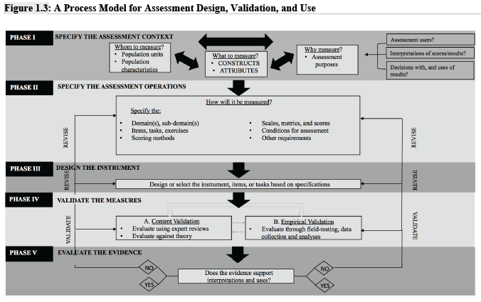

Slide 4
AGENDA- Foundational concepts
Measurement, Testing, Assessment, Evaluation- Definitions and distinctions
The Assessment Context: What to measure, in Whom, Why? ( What inferences will be made from test scores or measures? Who will use the results? For what purpose(s)—what are the specific, intended uses?)
The Assessment Operations: How we measure
  Operational definitions of constructs
  Measurement scales are embedded in the operations that we use to build instruments–four main types of scales, properties
The Process Model: a 5-phase model for assessment design and validation guided by the inferences and uses we want from the construct measures
  Classical Test Theory (CTT)
  Domain sampling theory as a part of CTT
  A branch of applied statistics called “psychometrics”

Slide 5
Assessment: A definition
"Whatever exists at all exists in some amount. To know it thoroughly involves knowing its
quantity as well as its quality" (Edward L. Thorndike, 1918, p. 16)
Assessment is:
A purposeful and disciplined set of procedures (embodied in an instrument) aimed at describing, quantifying, and facilitating inferences about degrees to which particular characteristic(s) exist in given groups of persons, objects, events, organizations/ entities.

Slide 6
Assessment
Common instruments:
Mental ability tests, attitude surveys, “workplace proficiency” assessments, or other instruments from your experience
What is measured: Constructs tapped? ( Concepts)
  Variables (measured constructs that vary in different members)
  Construct measures—types of scores generated by the scales and their arithmetic properties
  On Whom: Populations? Units of the Population
Why: Purposes for assessment-- Inferences (what do the scores denote?), Uses (specific purpose for the scores/data?)

Slide 7
Assessment: Applying the definition
EXAMPLE
What is measured (Construct): Temperature
Instrument: Thermometer
--Thermometers offer a built-in, systematic process to describe and quantify “how much” of the underling characteristic (temperature) is present in different units (entities or individuals)
--The end result of the assessment process is a set of numbers or numerals placed on a linear metric that shows how much the characteristic varies from unit to unit
--The thermometer focuses on one characteristic only (measures temperature only, not pressure or other characteristics), taps into one property or construct)
-The process focuses on a defined population (of individuals/ entities)
-Assessment is a purposeful activity (Thermometers useful for clinical evaluations—one purpose; also, meteorological evaluations)_

Slide 8
Distinctions
Testing and Measurement:
-A “test” is one type of assessment tool ( current consensus). Assessment is a broad term encompassing various types of instruments
-Measurement is a part of the assessment procedure –it is the “scale” or scaling component that yields the number or a numeral.
Evaluation:
-A judgement-based decision pertinent to whether a construct measure is “good” or “bad” for a given purpose
-Evaluative activities follow assessment
E.g. 1: Test yields a score of 40. Is this a good enough score to promote the student to the next grade?
E.g. 2: Thermometer yields a temperature of 101 degrees F. Is the individual ill with the Corona Virus infection? Decision on specific type of illness.

Slide 9
An example
SAT® -Scholastic Aptitude Test, renamed Scholastic Assessment Test, and now simply the SAT!
What? Taps into two main constructs: verbal ability and mathematical ability
Whom? High school students aspiring towards college
Why? To make interpretations --from SAT test scores-- about students’ college readiness levels (inferences) to make decisions about granting admission and/ scholarships (uses)
How? Assessment Operations: The SAT is a paper and pencil test or computer-administered test—it is a standardized instrument yielding different types of scale scores and data
SAT reports norm-referenced scores derived from “raw scores
Raw scores for SAT are Total Scores =sum of items answered correctly
Derived scores- e.g., Percentile Ranks (a norm-referenced score that places a raw score in a distribution of scores of similar test takers)
Other types of derived scores? Criterion-referenced tests (CRTs) vs. Norm-referenced tests (NRTs)vs. Ipsative tests

Slide 10
Some basic vocabulary
“ Constructs” –
“ Construct Measures”
“ Population”
4. “Measure-based Inferences vs Uses”-
5. “ How” –Assessment Operations
6. Operational Definition Methods and “operations” we use to tap into, measure or scale the construct of interest

Slide 11
Why? Assessment Purposes
Research and Science—Measurement is integral part of “doing research” in the quantitative sciences; helps expand knowledge about unknown constructs
Applied Decision-making in Practice and Policy Contexts
  Clinical assessment and diagnosis
  Classroom instruction, grading, educational decision-making
  Professional certification, selection, awards or recognition
  College admissions and entrance testing
  Institutional or program planning
  Program evaluation, accreditaton and accountability purposes
  Other?

Slide 12
What we want to assess…..
“ Constructs” = “ Concepts”= “Attributes”=“Trait”
Social Constructs: E.g., Socio-economic status
Cognitive Constructs: E.g., achievement, competency,
aptitude in a given domain (e.g., math)
Health-related Constructs: E.g, physiological well- being, diseases or disorders
Psychological Constructs: E.g., Attitudes, beliefs, personality traits, interests, dispositions, feelings
ASK: In whom? Identify the population units.

Slide 13
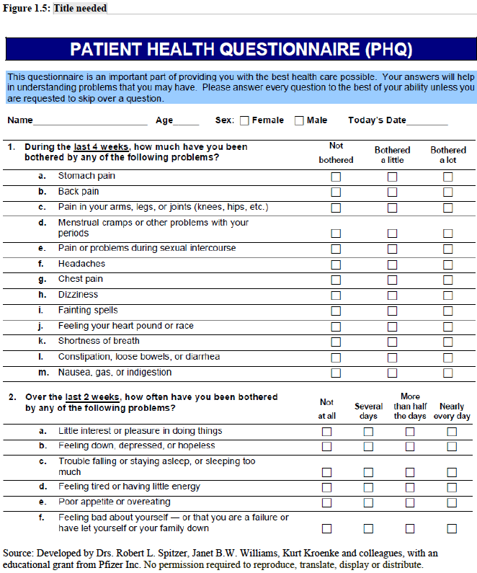

Slide 14
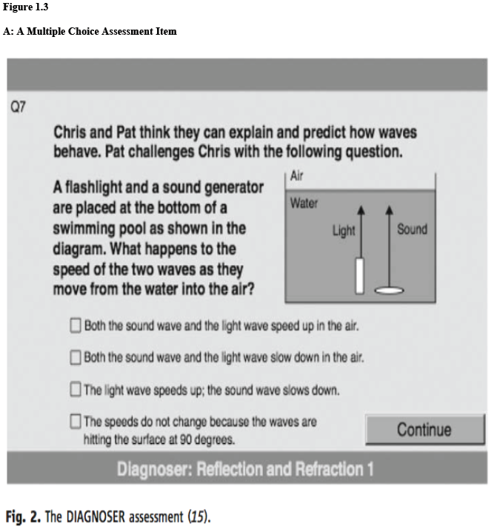

Slide 15
How we assess-
How? Assessment Operations—common assessment methods and modalities
  Multiple choice (structured response) tests
  Constructed-response tasks and essay assessments
  Portfolio-based assessments*
  Product-based assessments*
  Behavior-based and performance assessments*
  Interview-based assessments*
  Survey-based scales—e.g., attitude scales, self-reported or other-rated inventories*
  * Falls under “Performance Assessments”
  ALL must incorporate scoring protocols or rubrics, that help “scale” the construct and which yields numeric data

Slide 16
Scaling and Types of of Measurement Scales—End result of measurement process
Assessments incorporate different types of measurement scales.
Four types of scales (Taxonomy by Stevens, 1946)
Each yields “numerals”, “scores” or “measures” carrying different arithmetic properties and meanings
Nominal Scale
Ordinal Scale
Interval Scale
Ratio Scale

Slide 17
Scale of Measurement: Nominal Scale
Nominal Scale | Properties | Examples
Assessment Operations: Involves placing objects or individuals into different categories based on observable differences in an attribute. | •Numbers merely stand for names (hence, the descriptor "nominal") or labels of categories •No true meaning of a zero •No "more" or "less" value in numbers •Numbers cannot be arithmetically manipulated meaningfully Interpretation: Individuals assigned values of 1 are qualitatively different from individuals assigned values of 2 or those assigned values of 3, and so on. | •Gender “1" for males and "2" for females •Hair Color “1” for blonde, "2" for brown, "3" for black, "4" for other colors

Slide 18
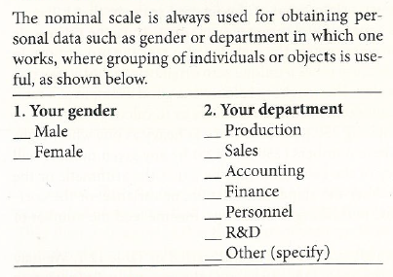
Nominal Scale– Survey item
Sekaran & Bougie, p. 216

Slide 19
Scale of Measurement: Ordinal Scale
Ordinal Scale | Properties | Examples
Assessment Operations: Involves placing objects or individuals in ordered categories based on direct comparison of how much an attribute is present. | •Numbers have a "more" or "less" value on an ordered continuum, but not equalsized intervals •Zero does not necessarily connote total absence of the attribute; just that there is less of it than in the next highest category, “1" •Meaningful arithmetic manipulations are limited because of only transitive properties Interpretation: Individuals with scores of 1 have less of the attribute than individuals assigned values of 2. Both 1 and 2 have less of the attribute than those with values of 3. However, with respect to the amount ofthe underlying attribute, the difference between 1 and 2 may not be the same as the difference between 2 and 3. | •Marks in a subject proficiency test A=Highest/ best quality B, C, D, F=Poorest/ worst quality •Rating scales, e.g., Likert scales

Slide 20
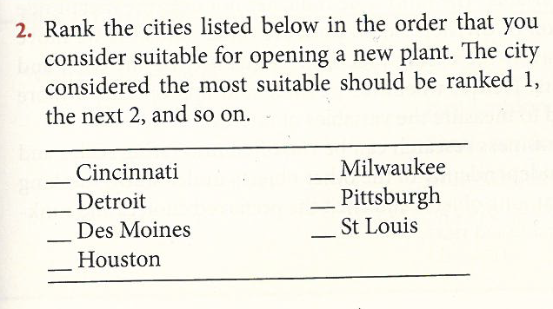
Ordinal Scale– Survey item
Sekaran & Bougie, p. 216-217

Slide 21
Scale of Measurement: Interval Scale
Interval Scale | Properties | Construct Examples
Empirical Operations: Involves placing objects or individuals in ordered categories that are at equal distances from each other, starting from an arbitrary zero. | •Numbers are on an ordered continuum, with equal-sized intervals that correspond with units of measurement •Zero is an arbitrary starting point for the scale; does not represent a true absence of the attribute •Meaningful arithmetic manipulations include adding and subtracting of scale units (cannot multiply or divide meaningfully because of arbitrary zero) Interpretation: Individuals with a score of 12 on an interval scale have 6 more units of the attribute than those with a score of 6; However, those with scores of 12 do not have twice more of the attribute than those with 6, because the distance from the true zero to 12 is not twice that of the distance from zero to 6. | •Centigrade scale for temperature 0=freezing point of water •Most standardized achievement tests, intelligence scales, and scales of psychological attributes

Slide 22
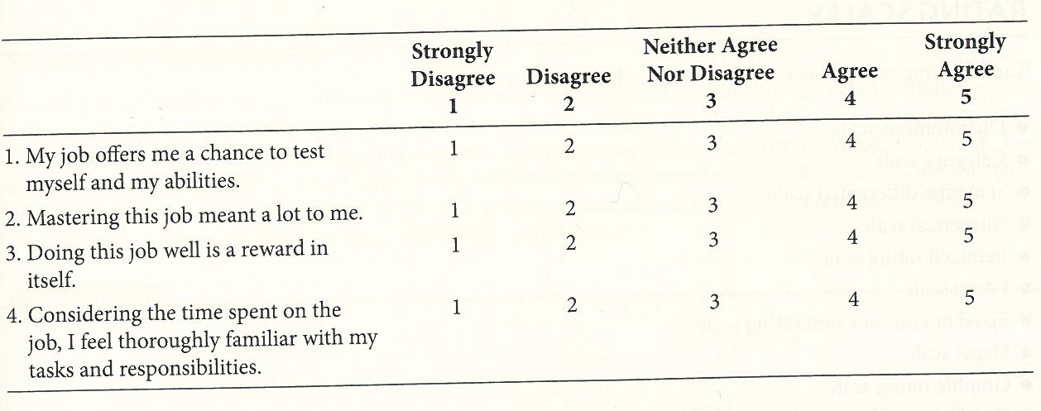
Interval Scale– Survey total score from a series of self reported, rated items with 1-5 Likert Scale
Sekaran & Bougie, p. 217

Slide 23
Scale of Measurement: Ratio Scale
Ratio Scale | Properties | Examples
Empirical Operations: Involves placing objects or individuals with different amounts of the attribute in ordered, equally distanced units, starting from a true zero. | •Numbers are on an ordered continuum, with equal-sized intervals that correspond with units of measurement •Zero is true; does denote a total absence of the attribute •Meaningful arithmetic manipulations include adding, subtracting, multiplying, and dividing. Interpretation: Individuals with a score of 12 on a ratio scale have twice more of the attribute than those with 6, because the true zero to 12 is at the starting point. | • Most physically observable traits --Height, weight, speed of movement

Slide 24
Person x Item Matrix
(Rating Scale Data from a survey)
Raw score or Marginal score
 | I₁ | I₂ | I₃ | I₄ | … | I_{n}
P₁ | 2 | 2 | 5 | 4 |  |  | 13
P₂ | 1 | 4 | 3 | 3 |  |  | 11
P₃ | 2 | 3 | 3 | 3 |  |  | 11
P₄ | 1 | 5 | 3 | 4 |  |  | 13
:
:
P_{n}
Items
Persons
Marginal score: 6 14
Classical Test theory (CTT):
Observed score (X) = True score (T) + Error (E)
Item Response Theory (IRT):
Using log-linear probability models to predict item responses from marginal scores ( NOT covered in ORL 5524)

Slide 25
Person x Item Matrix
(Binary Scale Data)
Raw score or Marginal score
 | I₁ | I₂ | I₃ | I₄ | … | I_{n}
P₁ | 0 | 1 | 1 | 1 |  |  | 3
P₂ | 1 | 0 | 0 | 1 |  |  | 2
P₃ | 0 | 0 | 0 | 0 |  |  | 0
P₄ | 1 | 1 | 0 | 0 |  |  | 2
:
:
P_{n}
Items
Persons
Marginal score
CTT: Observed score (X) is the Raw Score
X=True score (T) + Error (E)

Slide 26
Homework/Practice
See the PHP or Science Assessment Task
OR Select an assessment instrument of your choice in your profession or discipline.
Identify the:
  Construct(s)
  Population
  Assessment Purposes ( specific inferences and uses)
  How? Operations and type of measurement scale

Slide 27
Assessment Designer Makes the Design Choices
What design choices will you be making to operationally define the construct(s) of your choice?
WEEK 2 H.W/Practice
  Specify the Assessment Context for your Instrument (Phase I of the Process Model)

